Slide 1
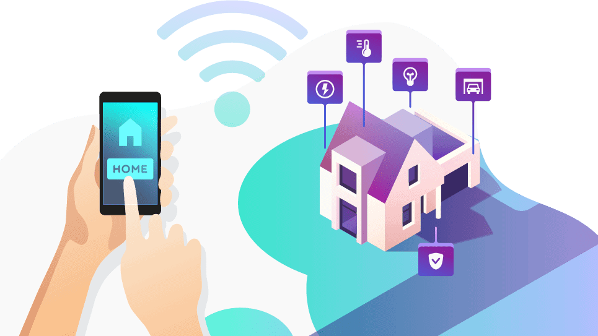
SMART HOME
Secured and Remotely controlled

Slide 2




Our Team
Md. Fahim Rahman
Mehnaj Sultana
Rafin Khan
Tanmoy Talukder
18.02.04.028
18.02.04.032
18.02.04.036
18.01.04.011

Slide 3
Objectives
Easy to use
Controll from anywhere
Using internet
We can operate Smart home just by using a android phone
We can operate our smart home from anywhere
Our Smart Home uses internet to operate.
Home Security
Automating Tasks
Preventing Accidents
We have implemented kinds of security features in our Smart home
We have automated some tasks in our Smart Home to ease our life.
Our Smart home is smart enough to prevent gas explotions.

Slide 4

Social values and we chose this project
01
Help disable persons
02
Save resources
03
Providing security that every home needs
04
Low price so that everyone can afford

Slide 5


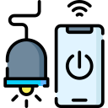

Features And Components

Slide 6
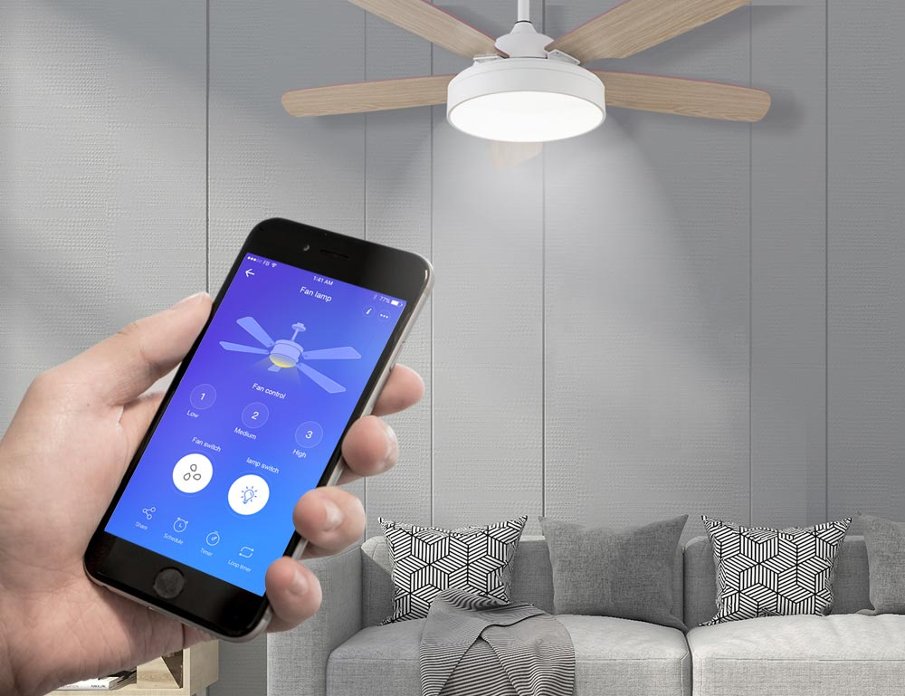
Controlling devices
Can control light from
Anywhere using phone
Component : NodeMCU,
Relay module

Slide 7
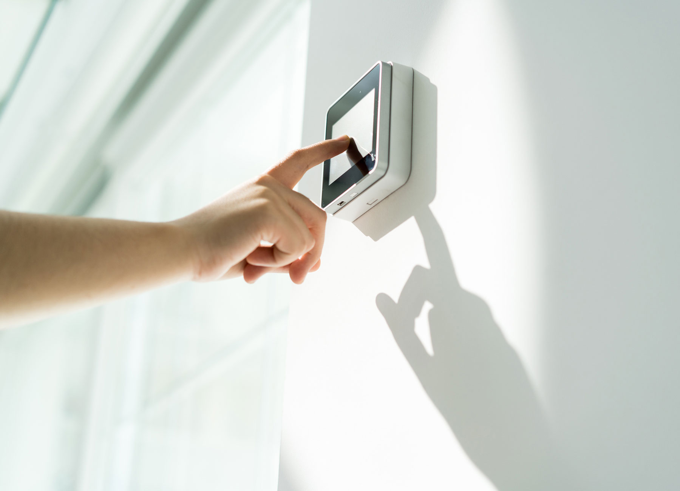
Security
We can lock our door with
Passwords.
Component: keypad

Slide 8
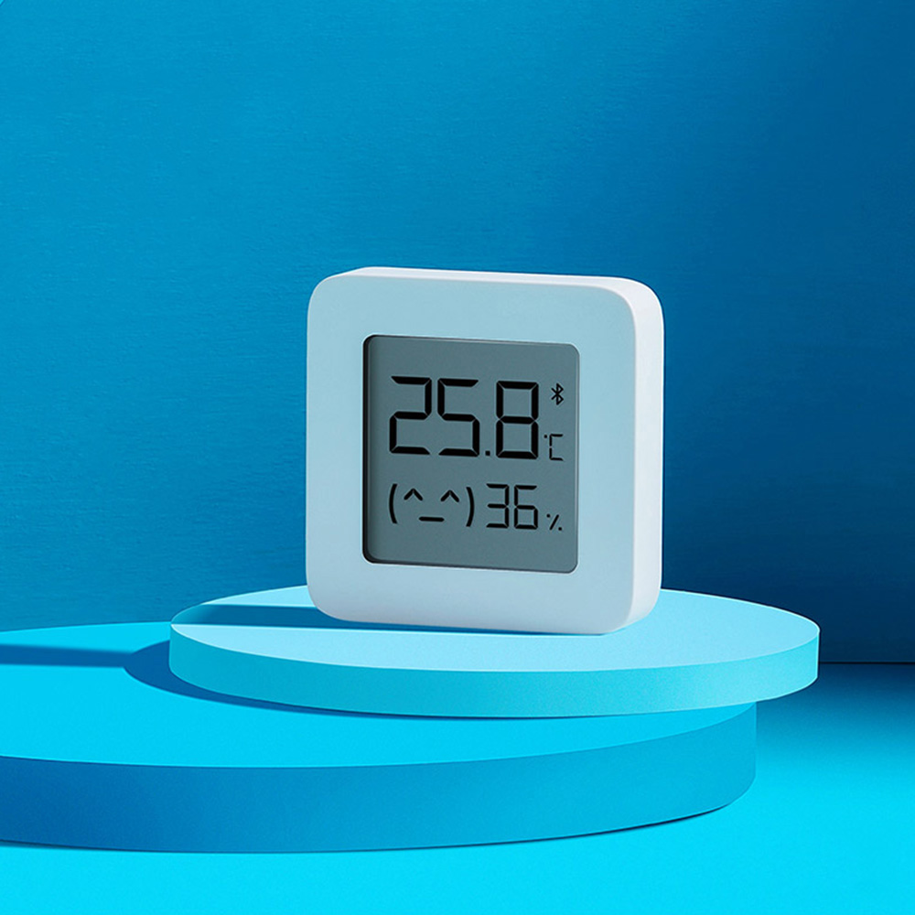
Temperature & Humidity
Can measure Temperature
& Humidity
Component: DHT11 Sensor
Module

Slide 9
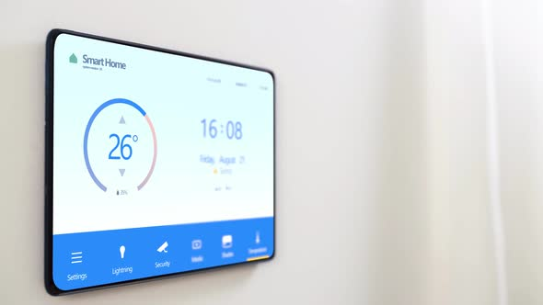
Showing Information
Our Smart home can show
Messages, temperature and
humidity
Component: LCD Display

Slide 10
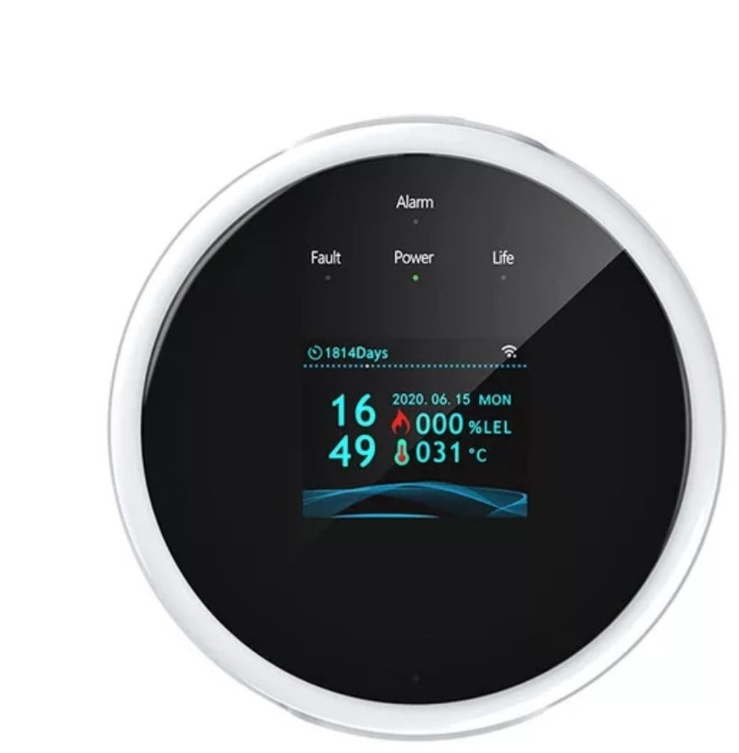
Preventing Accidents
Our Smart home detects gas
leakage
Component: Gas Sensor

Slide 11

Alarms
Smart home will alert us
If any unwanted event occurs.
Component: Buzzer

Slide 12
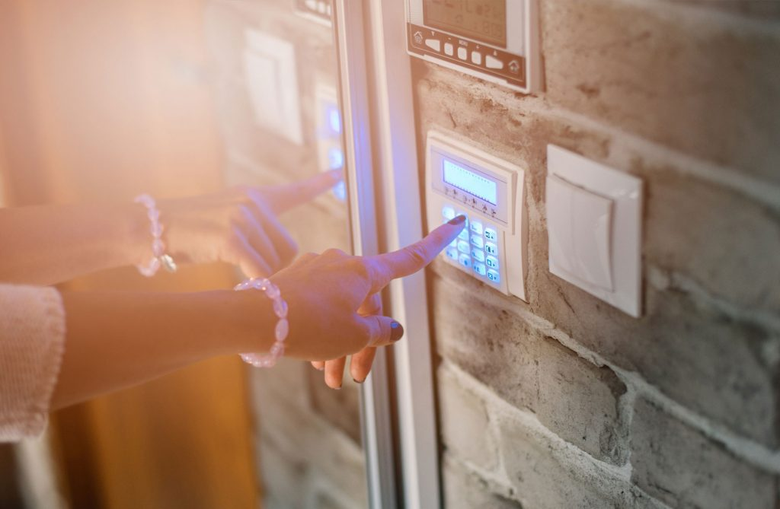
Operating Doors
Doors can be opened and closed
With keypad
Component: Matrix keypad,
Servo motor

Slide 13
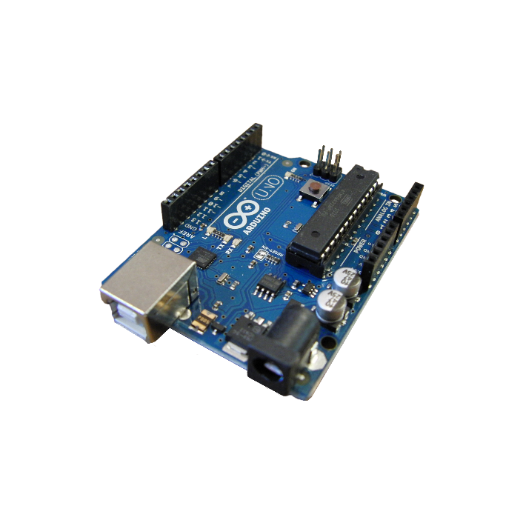



Other components:
Arduino
NodeMCU
battery
battery charger,
wire
breadboard etc

Slide 14
Estimated Budget
Our estimated budget for this project was 3906 taka.
Finally costed 4326 taka

Slide 15
Future plan
Security Camera with Features
Solar system use
More secure
Voice control over the System
Email notification
Spy protector

Slide 16
Thank You

